Slide 1
Data Cleaning and Tidying
Dr Jon Minton
Jonathan.minton@glasgow.ac.uk

Slide 2
Introduction
Pipes and porcelin: Plumbing and architecture
Research as plumbing
Information for humans, data for computers
Tidy data concepts and ideas
The target structure
‘Messy data’ examples
Tools for data tidying
Further reading

Slide 3
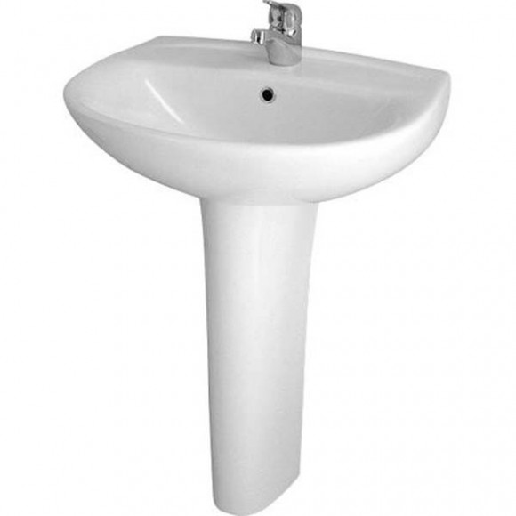
Pipes and porcelin
What are your needs as a user?
What needs to happen to meet your needs?
What can go wrong? How are problems fixed?

Slide 4
Academic Research is architecture AND plumbing
 | Essay Writing | Qualitative Research | Quantitative Research
Architecture | Answering the research question | Understanding theoretical framework Thinking about methodology | Operationalising Choosing statistical tests
Plumbing | Writing the title Reading Grammar Defining the search | Scheduling interviews Filing ethics forms Travel? | Get the data Understanding the software

Slide 5
Information and data
People want information
Computers need data

Slide 6
Example: Car and Van ownership in Scotland
Why might we be interested in car and van ownership in Scotland, and how it has changed between 2001 and 2011?
What are the differences between each of these files?
2001 census
Initial file
Modified
2011 census
Initial file
Modified
Combined

Slide 7
Data tidying for easier control
Tap controls
Up: more; down: less
Left: warmer; right: colder
An important aim of data management is to get the data into a form where you can control what you get more easily
How was this achieved with the previous example?

Slide 8
A target tidy data form
Datazone | Local authority | year | total | none
‘Where’ variables |  |  | ‘What’ variables
What variables: Report measured values
Where variables: Describes the characteristics of what was measured

Slide 9
Derived variables: ‘window variables’
Datazone | Local authority | year | total | none | Proportion without a car or van | Proportion with a car or van
‘Where’ variables |  |  | ‘What’ variables
Window variables make the dataset wider (More columns)
But the data still has as many rows
Example using Excel:

Slide 10
Derived variables: ‘summary variables’
Local authority | year | Total by LA and year | None by LA and year
‘Where’ variables |  | ‘What’ variables
Summary variables reduce the size (number of rows) of the data
What is the example above
Example using Excel

Slide 11
Tools for data management
Excel
Tidying: concatenate, split, remove white space, delete empty rows and columns
Window functions: adding new columns with formula (sum, average, if statements)
Summary functions: pivot-tables
Merging: vlookup etc
SPSS
Merge, recode, summarise, etc
Use the GUI but then look at the formulae
Many approaches, software, tools

Slide 12
The most important tool
A clear idea of what you want to achieve
Tidy data principles, ‘target forms’
MOTIVATION
Substantive interest in the phenomena you want to investigate

Slide 13
Further viewing and reading
Hadley Wickham, ‘Tidy Data’
http://www.jstatsoft.org/v59/i10/paper
Focus on the examples, not the methods/case study described later.
Hadley Wickham’s Presentation
https://vimeo.com/33727555
Again, focus on the examples
For more information, contact me:
Jonathan.minton@glasgow.ac.uk

